Slide 1




I-74 Corridor over the Mississippi River
Submitting Firms:
Benesch and
Modjeski & Masters
Client:
Iowa Department of
Transportation
Location: Quad Cities, Iowa and Illinois

Slide 2
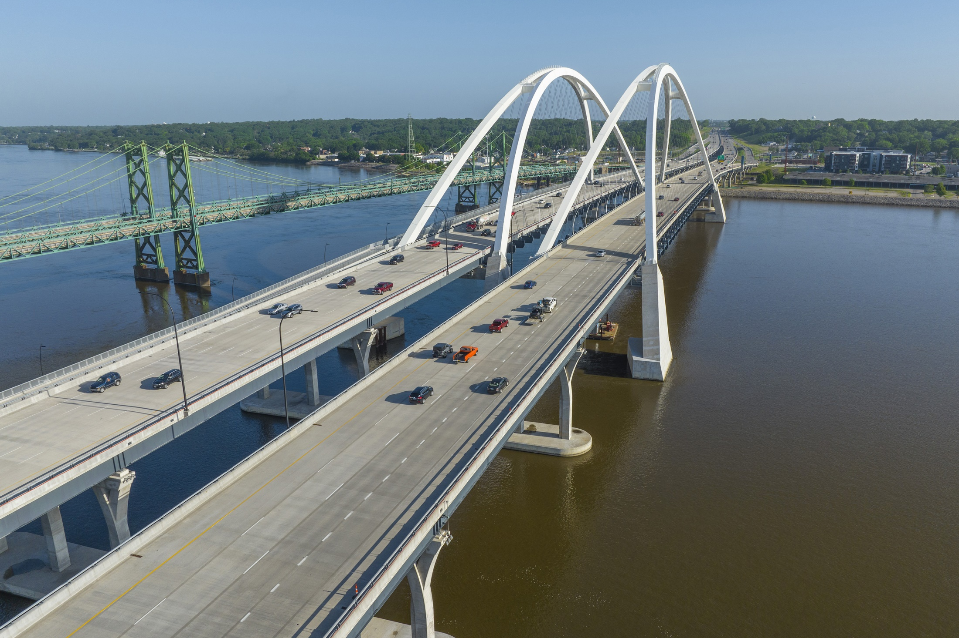
Photo 1: The basket-handle through-arch bridges are the longest spans of this type carrying vehicular traffic in the U.S.

Slide 3
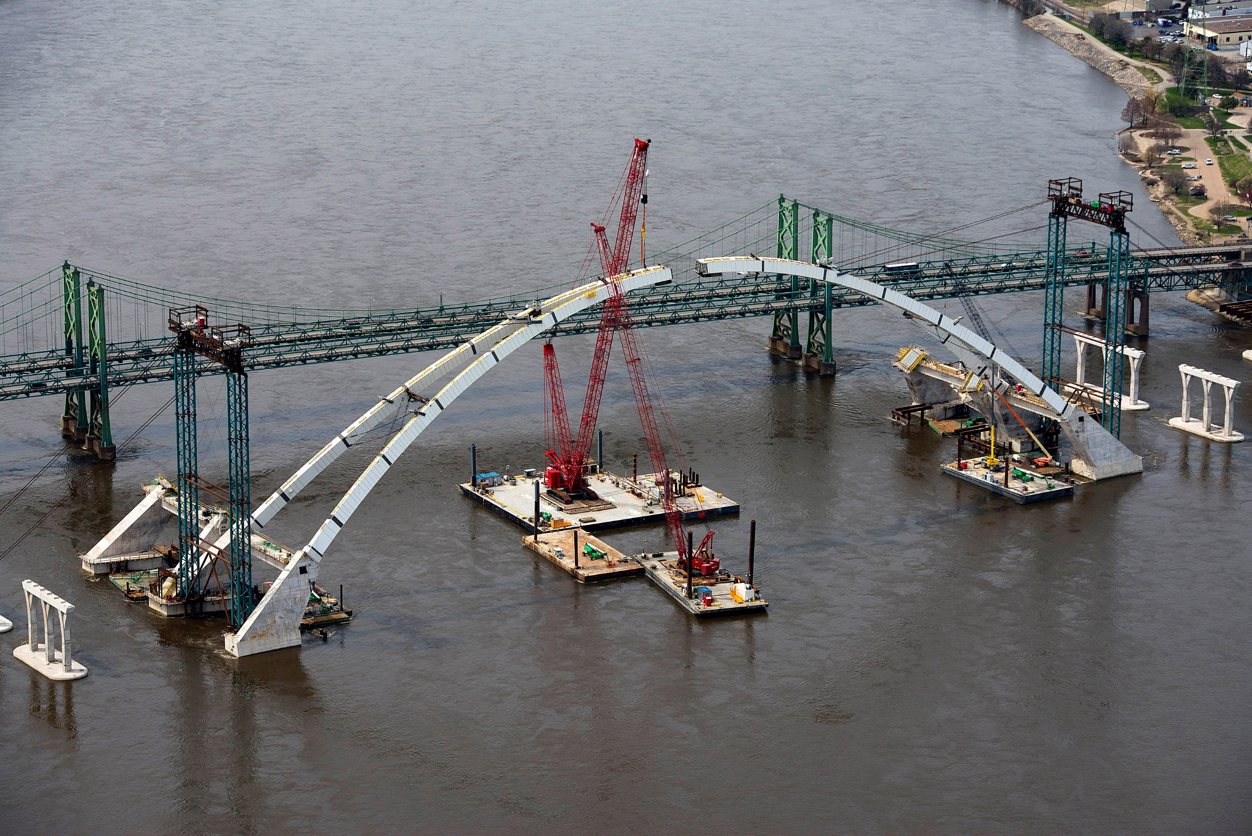
Photo 2: Preparing for installation of the Keystone Segment on the I-74 Westbound bridge.

Slide 4
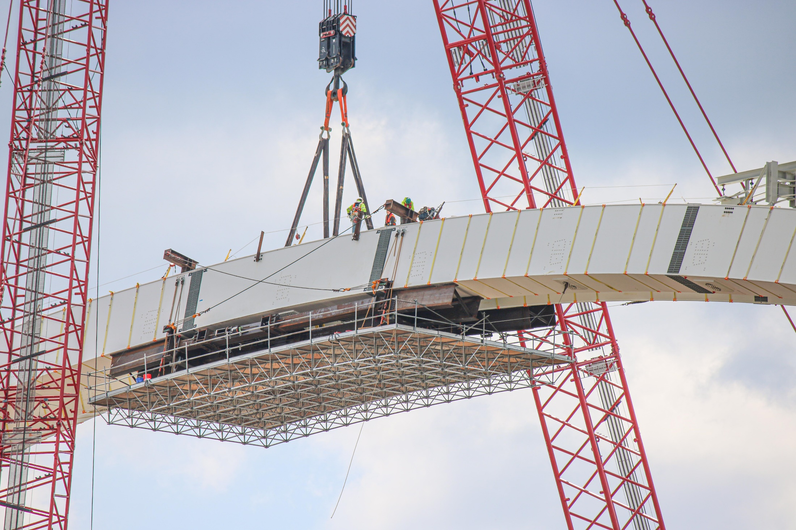
Photo 3: Installation of the Keystone segment on the I-74 Westbound bridge.

Slide 5
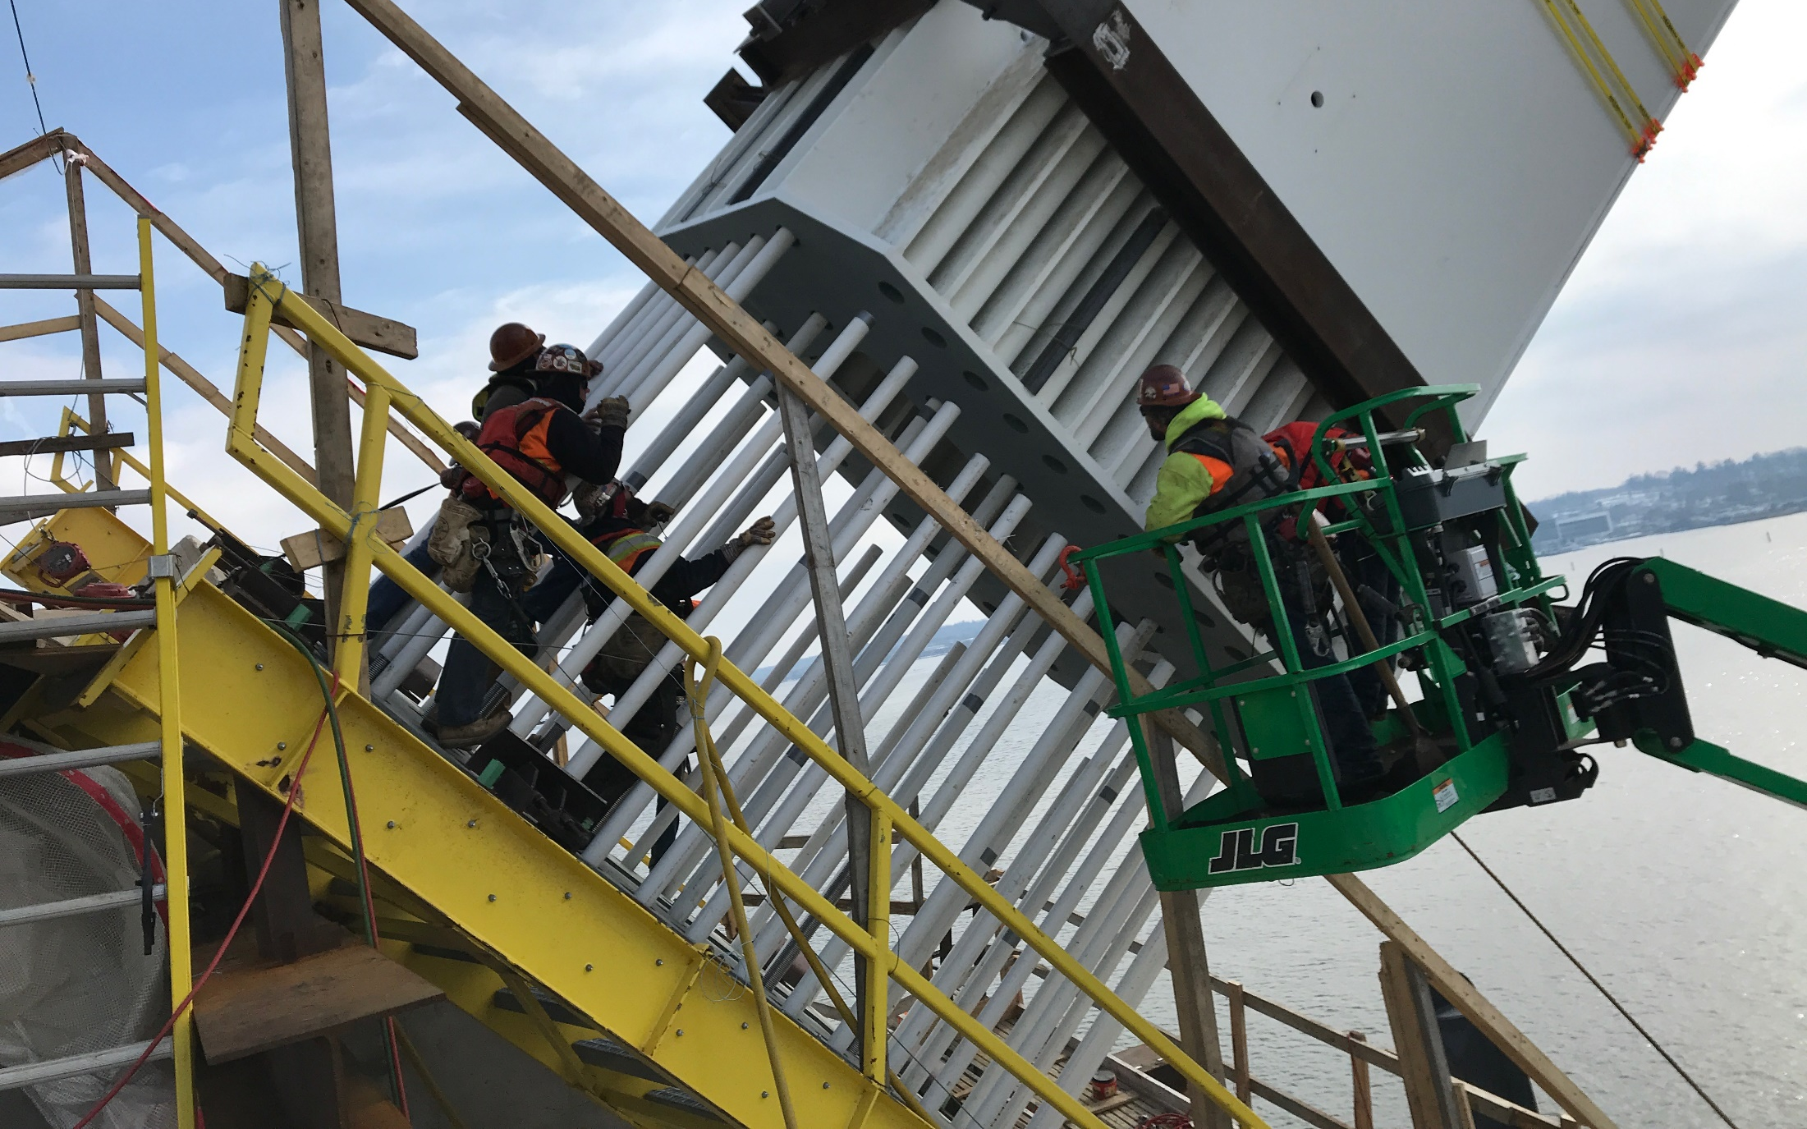
Photo 4: Installation of the base segment of the I-74 arch rib over the custom stainless steel anchor rods.

Slide 6
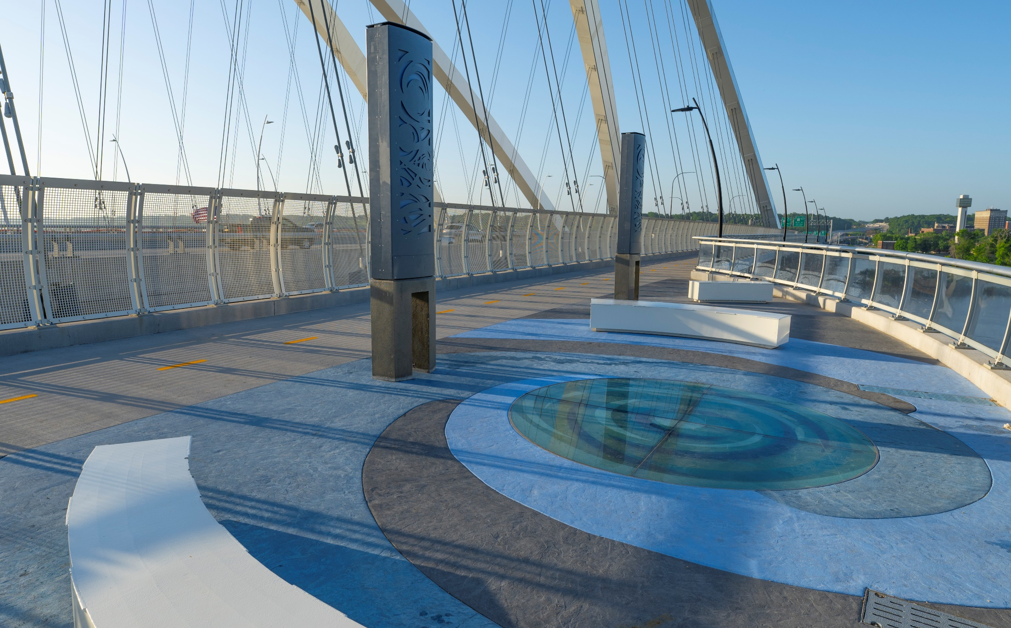
Photo 5: The bridge features a unique, 14-foot-wide bicycle and pedestrian path that cantilevers outboard of the arch rib and offers a scenic route for pedestrian and cyclists. This photo, at midspan of the arch, shows the glass oculus that allows users to look down on the river below.

Slide 7
Photo 6: Fireworks over the new I-74 bridge on December 1, 2021.

Slide 8
