Slide 1
ACEC Economic Outlook
Thomas Grogan, Senior Director
June 2023

Slide 2
Welcome!
Economic Indicators for June 2023
The Engineering Business
A/E Revenues
Construction Spending
The US Economy at Large
Inflation
Activity
Looking Ahead

Slide 3
A/E Revenues
Total revenues up 1.8% compared to Q4 2022
Total revenues up 10.5% YoY
Source: US Census Quarterly Services Survey, June 2023

Slide 4
Construction Spending
Total Construction up 7.2% YoY in April 2023
Subsectors show different story with residential spending down -9.2% YoY
Mortgage rates at highest sustained levels in 15+ years
Non Residential Private Construction up 31.1% YoY
Source: US Census Value of Construction Put in Place Survey, June 2023

Slide 5
Construction Spending
Source: US Census Value of Construction Put in Place Survey, June 2023

Slide 6
Construction Spending
Top Construction (Public & Private) Year to Date Project Growth by Classification
Project Classification | YTD Spending Jan - Apr 2022 (millions) | YTD Spending Jan - Apr 2023 (millions) | Percent Change | Absolute Change (millions)
Total Manufacturing | $366,389 | $669,850 | 82.82% | $303,461
Total Lodging | $65,265 | $92,075 | 41.08% | $26,810
Total Water supply | $77,914 | $99,304 | 27.45% | $21,390
Total Sewage and waste disposal | $118,075 | $149,496 | 26.61% | $31,421
Total Commercial | $415,743 | $514,212 | 23.69% | $98,469
US industrial policy is promoting the reshoring of the supply chain
CHIPS and Science Act, Inflation Reduction Act, DOE Loan Program Office
Increased private investment in these sectors
Source: US Census Value of Construction Put in Place Survey, June 2023

Slide 7
Inflation
While Federal Reserve did not increase the Fed Funds rate at the last FOMC, the message is inflation is not under control
Services account for ~70% of consumer spending and those prices remain elevated
Source: US Bureau of Labor Statistics, June 2023

Slide 8
Inflation
This is not limited to consumers and household budgets
Good news is these costs are coming down (slightly) from 2022 Q3 (most recent DOT HCCI data)
Source: US Bureau of Labor Statistics, US Department of Transportation, Engineering-News Reports, June 2023

Slide 9
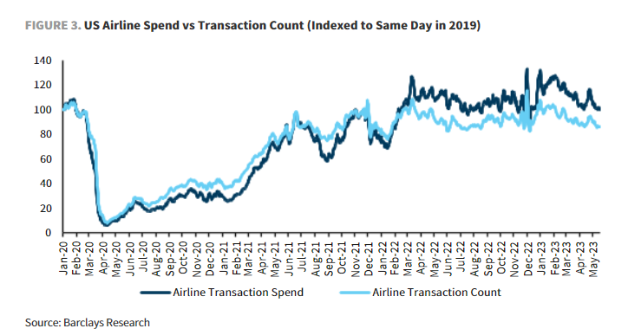
Activity
People are travelling at ~90-95% of levels compared to pre-Pandemic based on different indicators
Transit ridership still low (-30%) mostly due to changes in telework, commute patterns in major urban areas
Source: US Department of Transportation
via AlphaSense
Notes:
https://www.apta.com/research-technical-resources/transit-statistics/ridership-report/

Slide 10
Looking Ahead
Next FOMC meeting July 25-26
Personal consumption expenditures
Unemployment claims
Office/Commercial Real Estate
Increased vacancy rates
Increased distressed loans
Notes:
Vacancy - https://www.cushmanwakefield.com/en/united-states/insights/us-marketbeats/us-office-marketbeat-reports
MSCI Report - Increase in distressed loans https://www.bloomberg.com/news/articles/2023-06-22/distressed-us-commercial-property-assets-swell-to-64-billion
Capital Economics - https://www.bloomberg.com/news/articles/2023-06-22/office-owners-get-dire-warning-rebound-unlikely-before-2040

Slide 11
Thank You
Thomas Grogan
Senior Director,
Economics & Private Markets
202-682-4303
tgrogan@acec.org
www.acec.org

