Slide 1
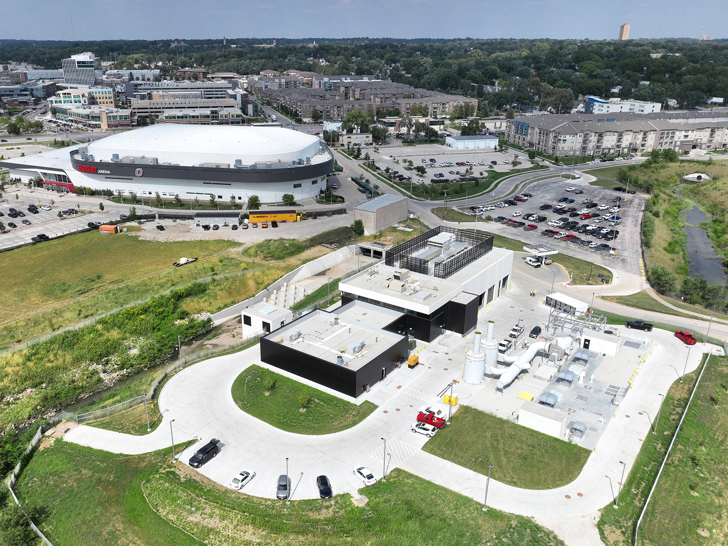



Saddle Creek High Rate Treatment Basin
Omaha, NE

Slide 2

Photo 1: The Saddle Creek High Rate Treatment Basin (HRTB) is the first remote facility of its kind built in Nebraska to store and treat combined sewer overflows during storm events to reduce impacts on local waterways. It is a milestone achievement in the City of Omaha’s $2-billion Clean Solutions for Omaha program to improve water quality, and an aesthetic compliment to the surrounding area.

Slide 3
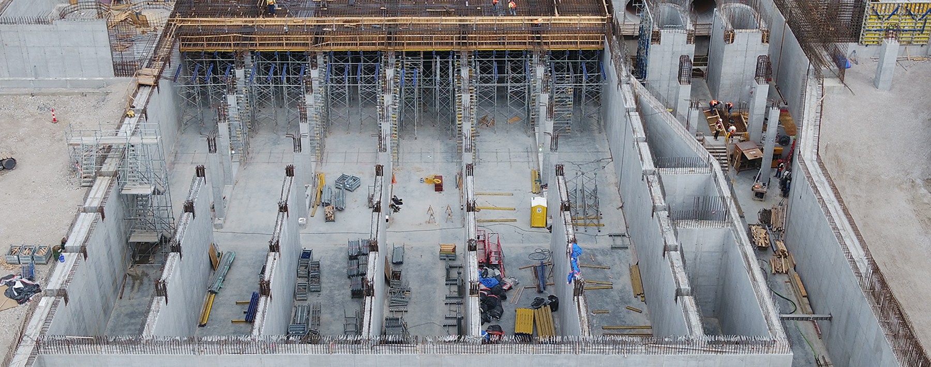
Photo 2: Sited on a construction debris landfill, significant excavation was required to remediate the site and deep foundation support systems were used to address soft soil conditions and support the mass concrete underground structure. Groundwater and ground movement were monitored to allow for proper backfill placement.

Slide 4
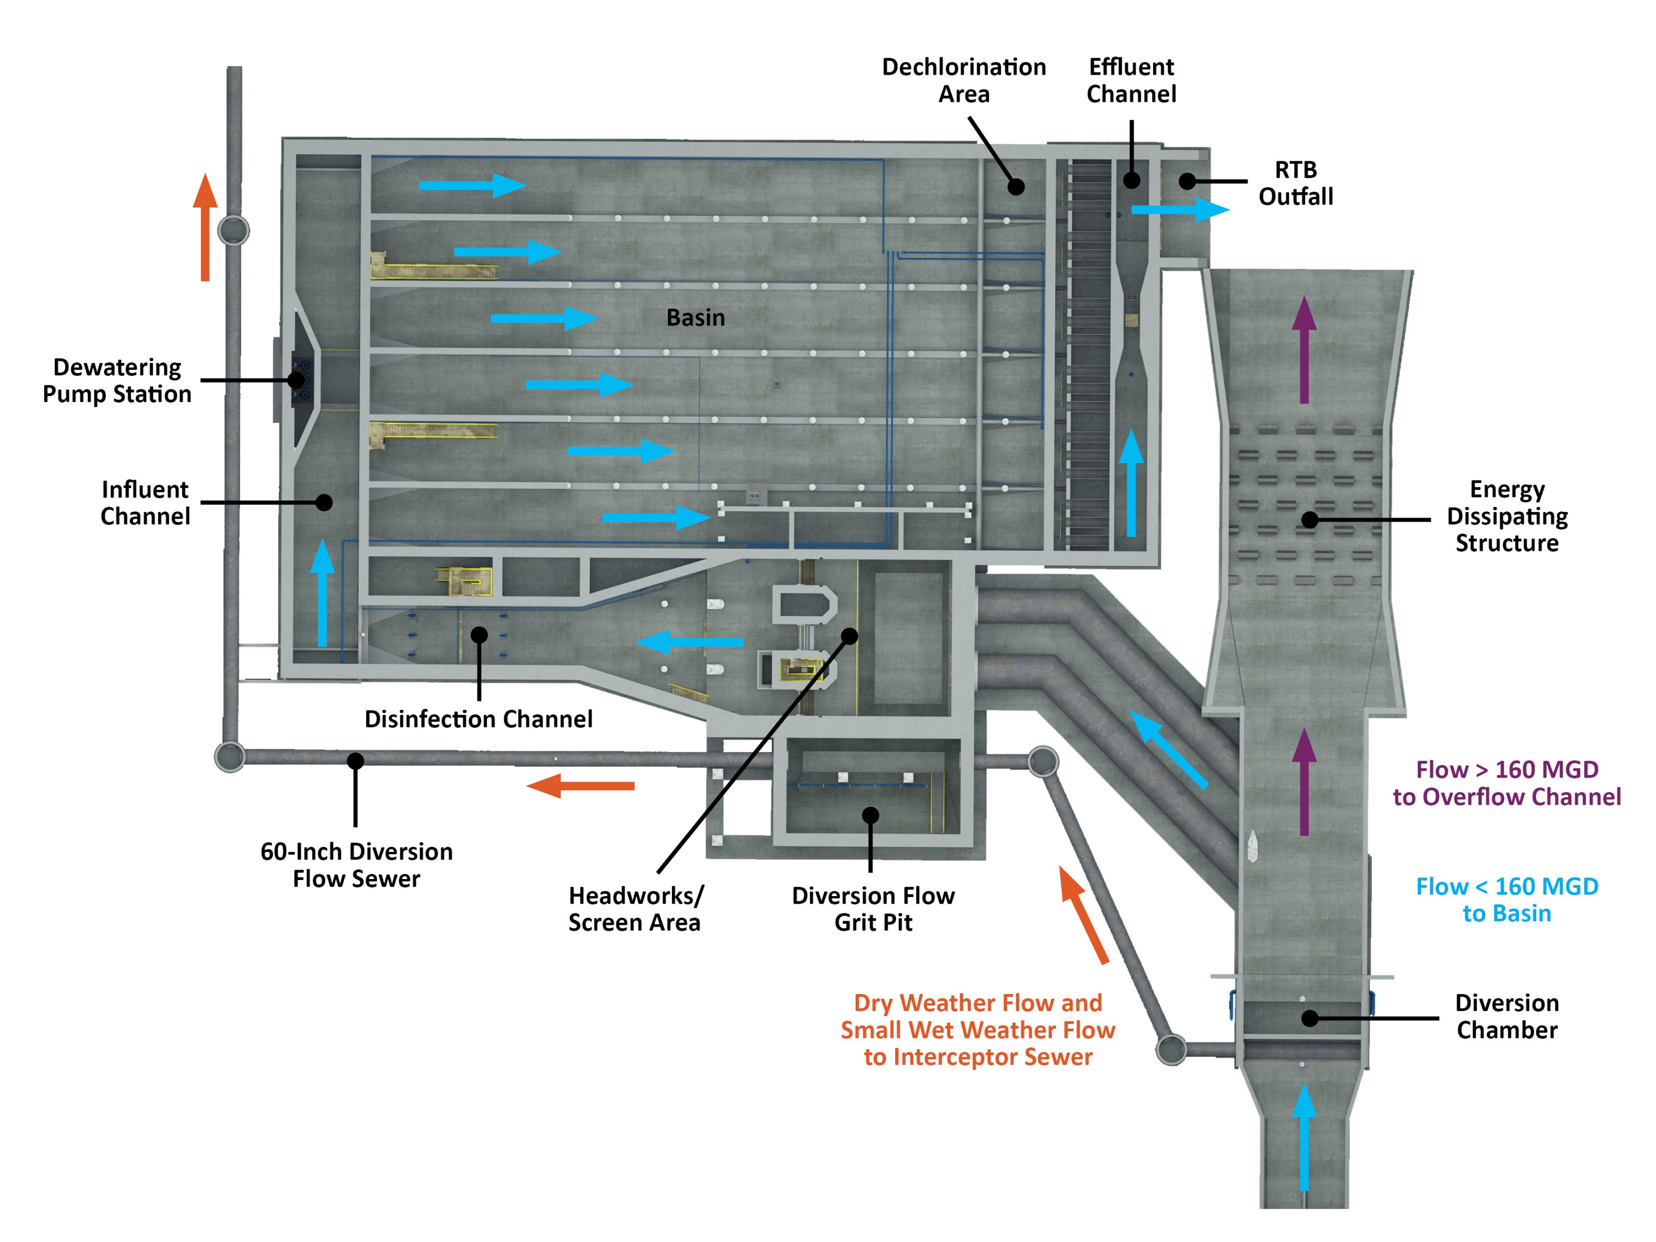
Photo 3: Key process elements enable the HRTB to operate efficiently and cost-effectively over a wide range of wet weather conditions without adversely affecting the collection and treatment system. Low flows are routed to the interceptor sewer to avoid unnecessary basin use. High flows are routed to the basin with an innovative gravity-flow-through design that removes solids and floatables, disinfects and detains flows for at least 30 minutes, and dechlorinates flows before discharging into the Little Papillion Creek. Flows that exceed the HRTB’s design capacity are routed directly to the overflow channel.

Slide 5
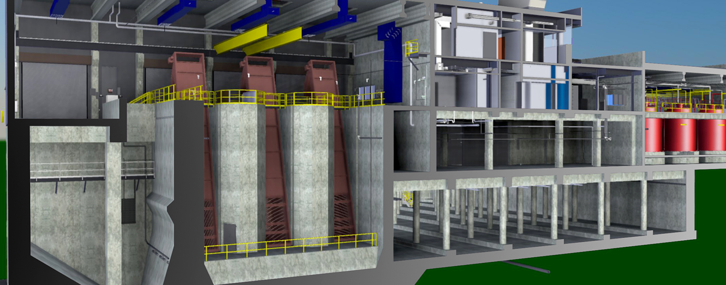
Photo 4: Building Information Modeling (BIM) helped reduce conflicts, promote stakeholder understanding of the project, and support contractor bidding. During facility start-up, the digital twin enabled simulated operation for a range of conditions to test performance.

Slide 6
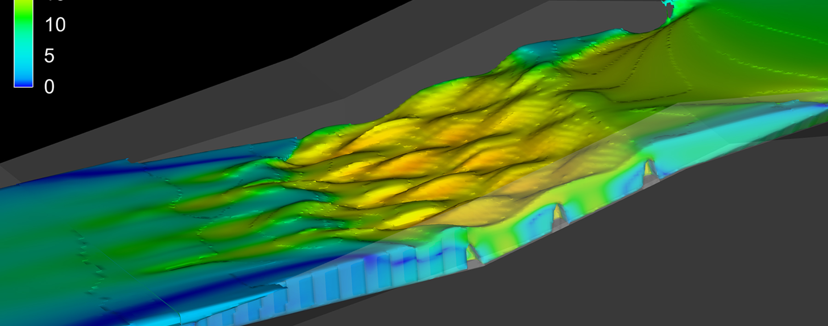
Photo 5: Advanced hydraulic modeling of the intake structure and basin layout was essential to meeting all required treatment needs while streamlining flows through the tank. Modeling demonstrated that the HRTB could disinfect flows with 30 minutes of settling time in compliance with the City’s CSO Long Term Control Plan.

Slide 7
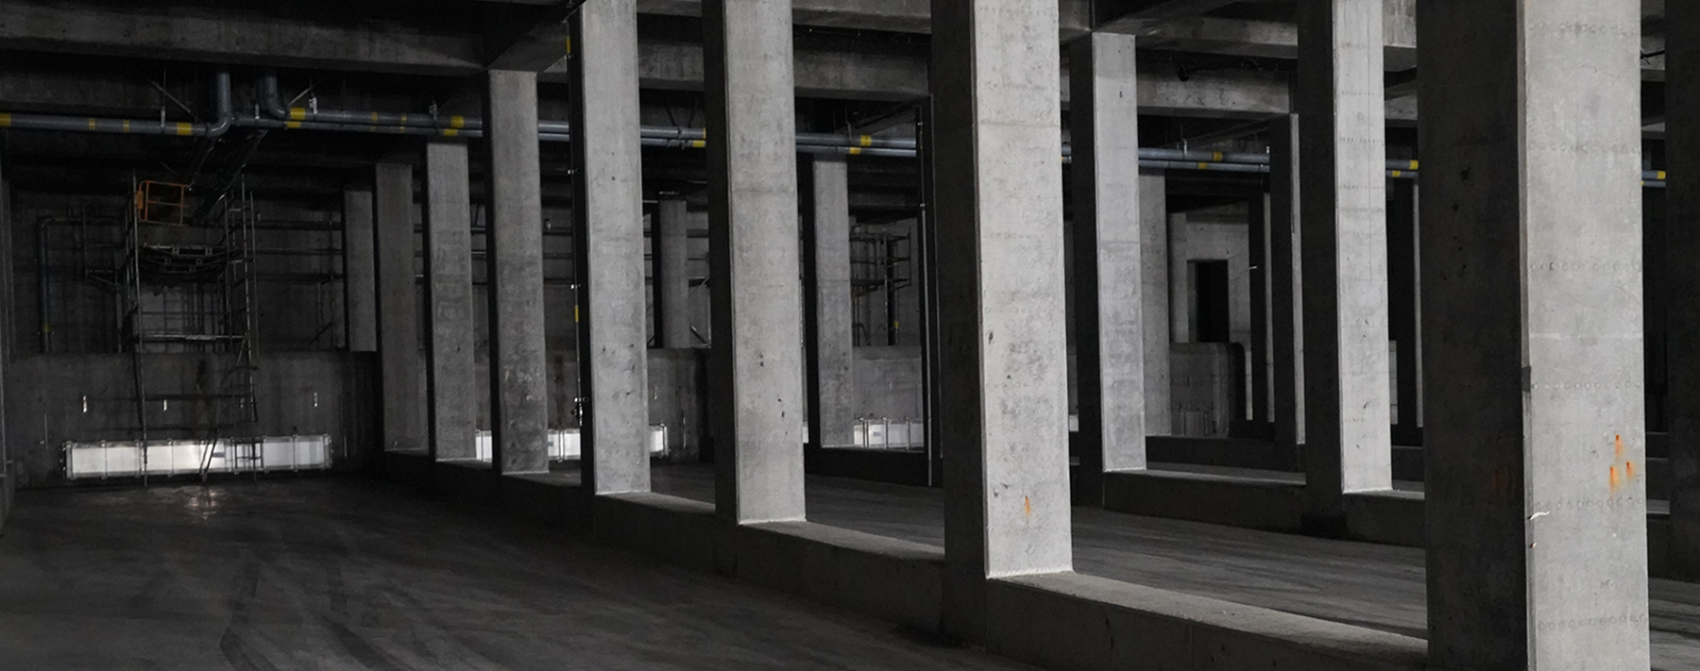
Photo 6: The 3-million-gallon, underground, concrete basin provides “equivalent to primary” treatment of combined sewer flows up to 160 million gallons per day (MGD). High-rate treatment technology provides efficient contact times, high mixing intensity, and increased disinfection dosage to remove pollutants, including pathogens and bacteria, that may impact the Little Papillion Creek and ultimately the Missouri River.

Slide 8
