Slide 1

Morrow Repower Project
Purvis, Mississippi
Burns & McDonnell

Slide 2
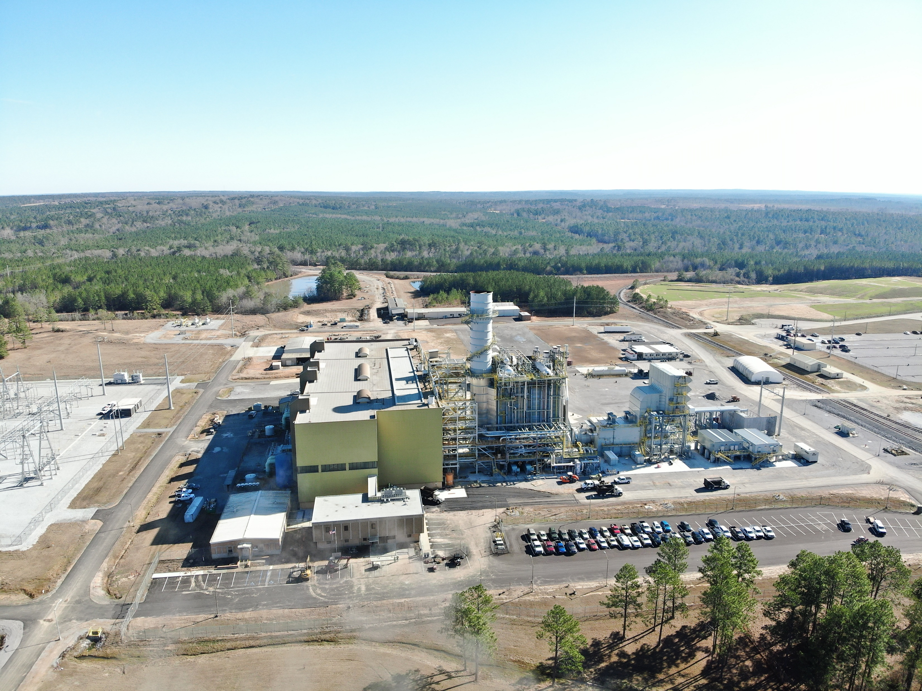
Photo 1: R.D. Morrow Sr. Generating Station: New gas turbine and associated HRSG were integrated into the existing steam turbine building.

Slide 3
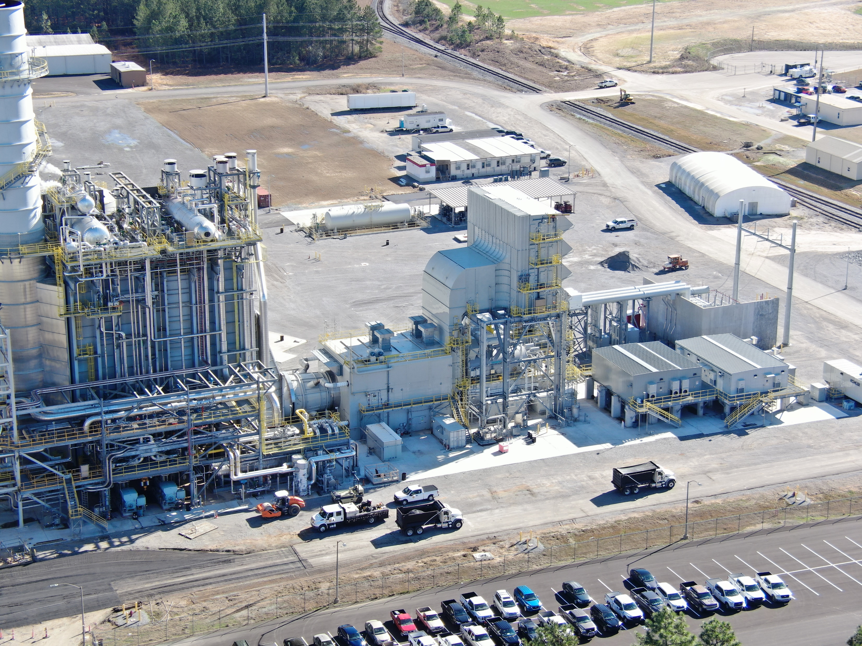
Photo 2: New power block area. Siemens 9000HL gas turbine with a Nooter-Ericksen triple pressure HRSG.

Slide 4
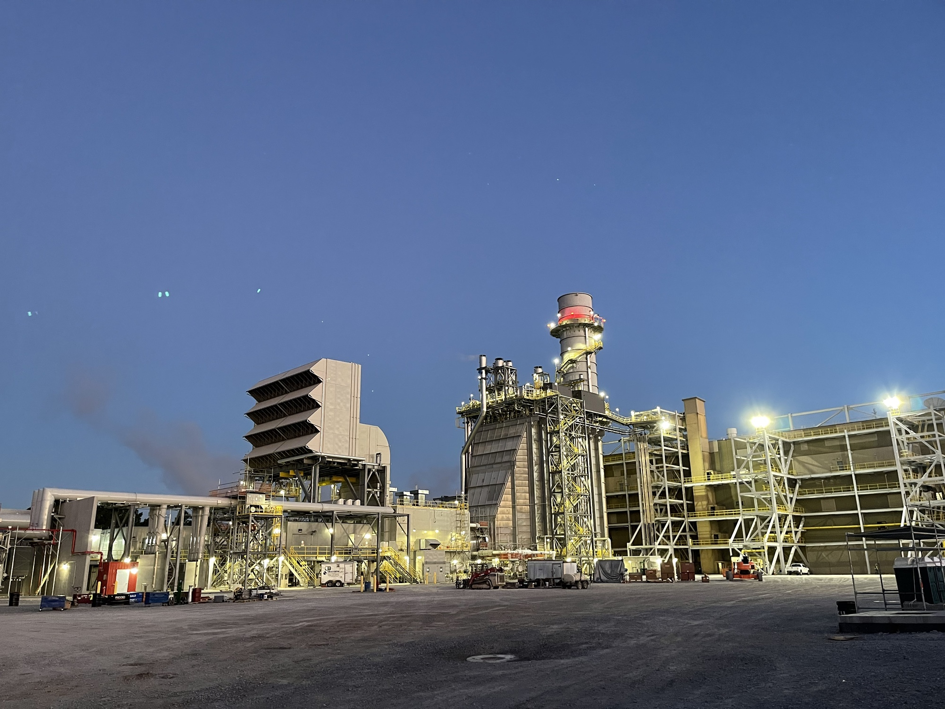
Photo 3: Unit at dusk. HRSG access integrated into existing building access and elevator.

Slide 5
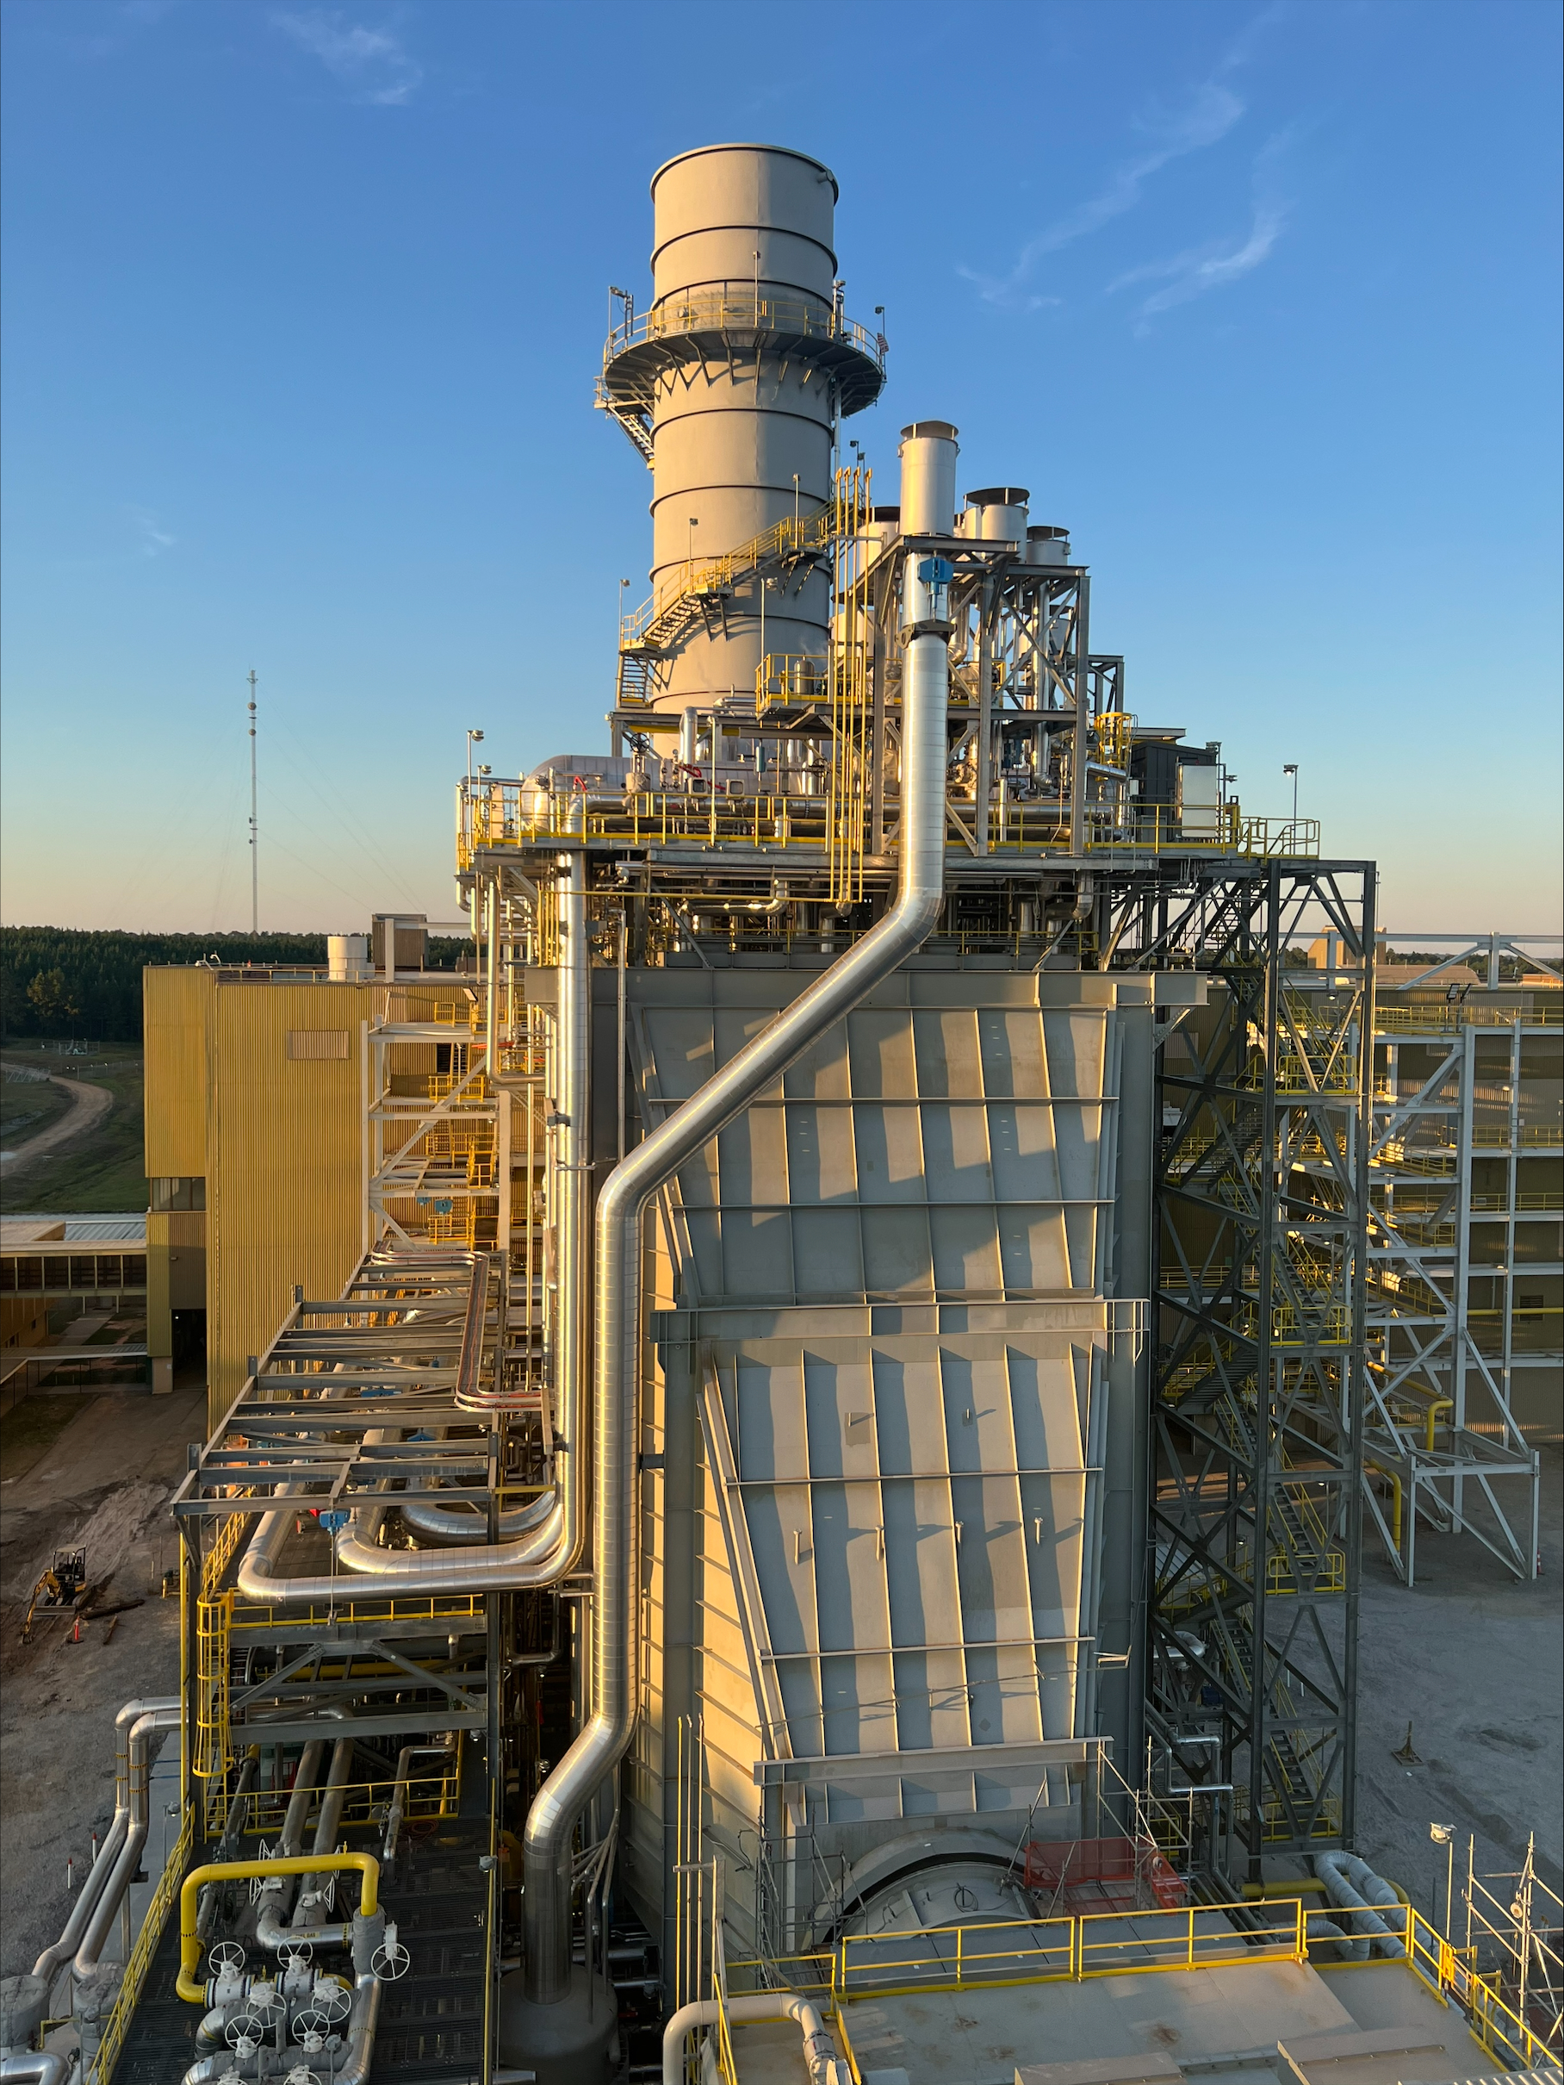
Photo 4: HRSG steam lines routed into existing building integrating into existing steam system.

Slide 6
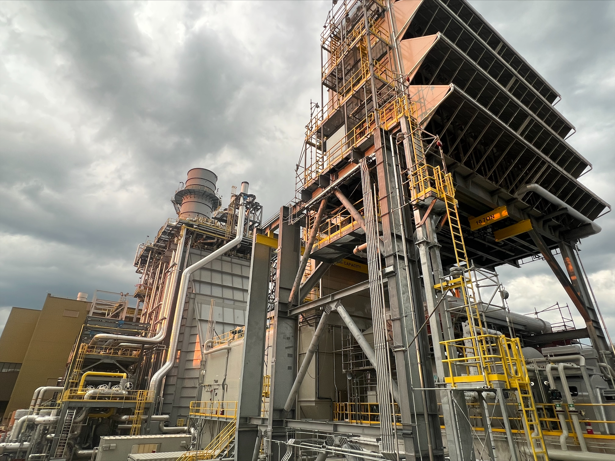
Photo 5: Gas turbine air inlet system.

Slide 7
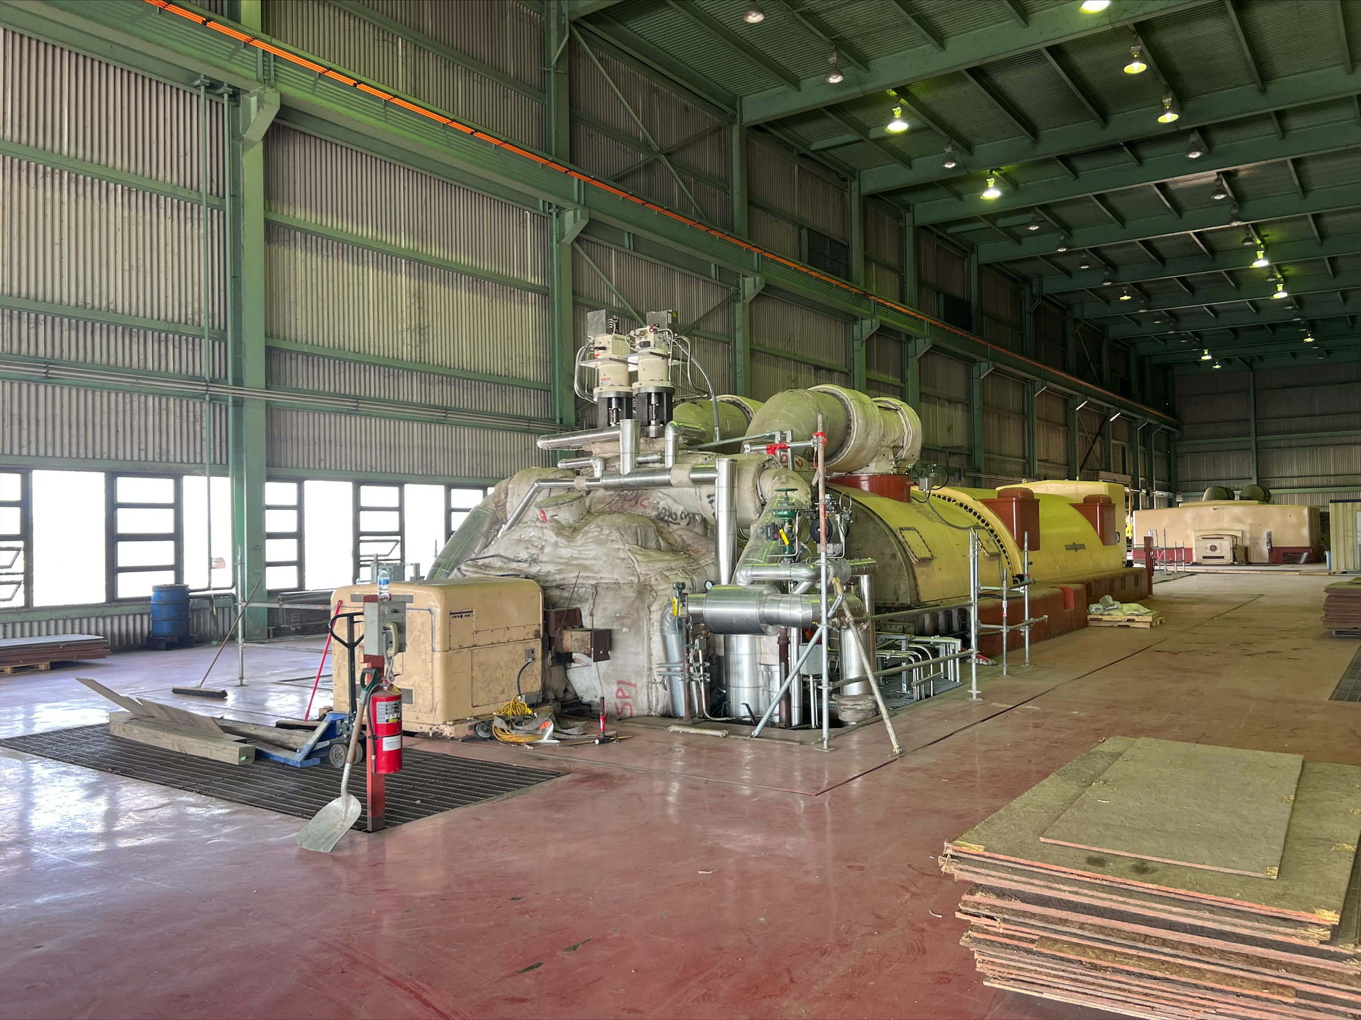
Photo 6: Existing steam turbine utilized to produce a highly efficient heat recover repower generating plant.

Slide 8
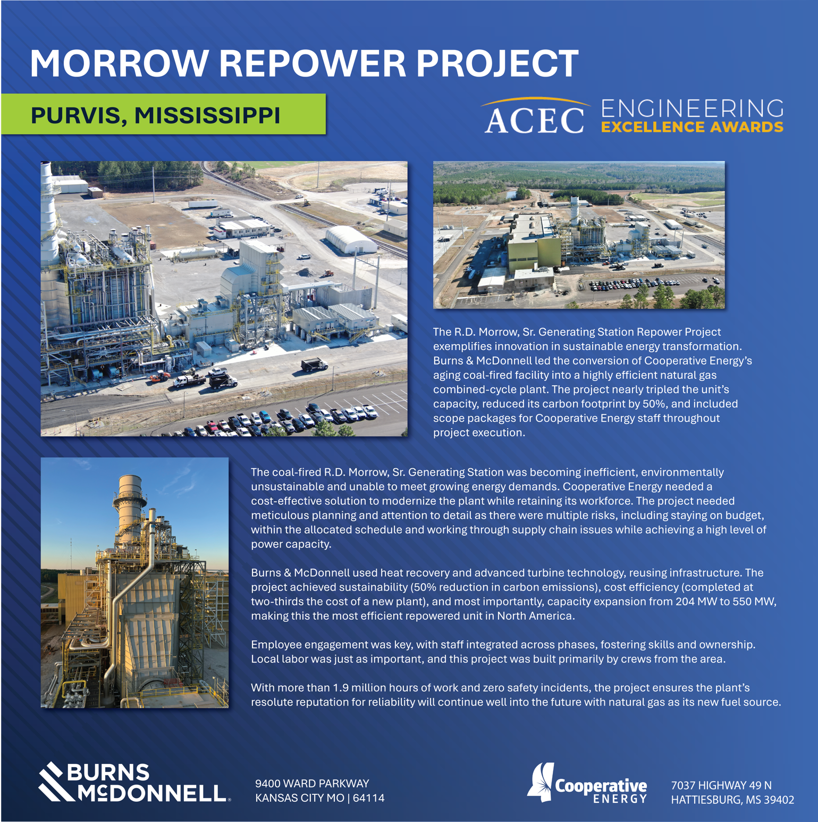
Insert Graphic panel

