Slide 1
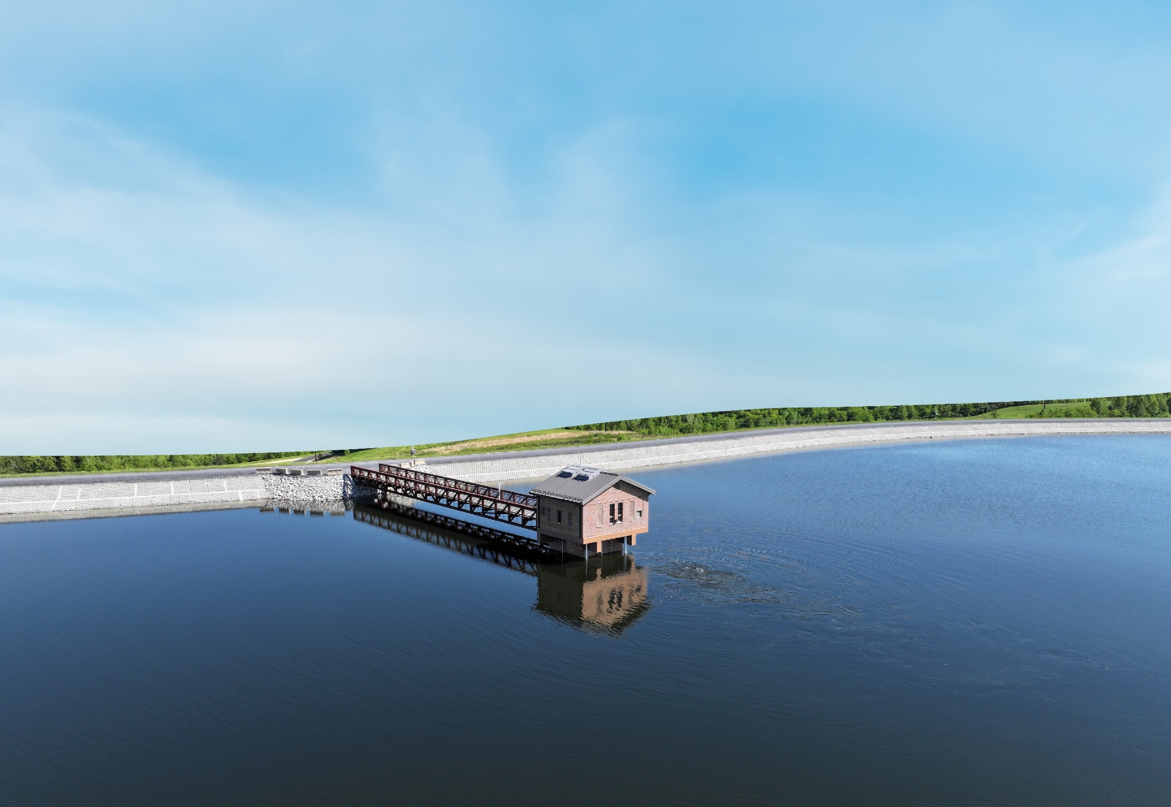


Virgil R. Hazelett Reservoir at Cobbs Creek
Submitting Firm
Arcadis U.S., Inc.
Entrant’s Role in the Project: Lead Engineering Consultant
Client/Owner
Henrico County Department of Public Utilities
Project Location: Columbia, VA
Location: Columbia, Virginia

Slide 2
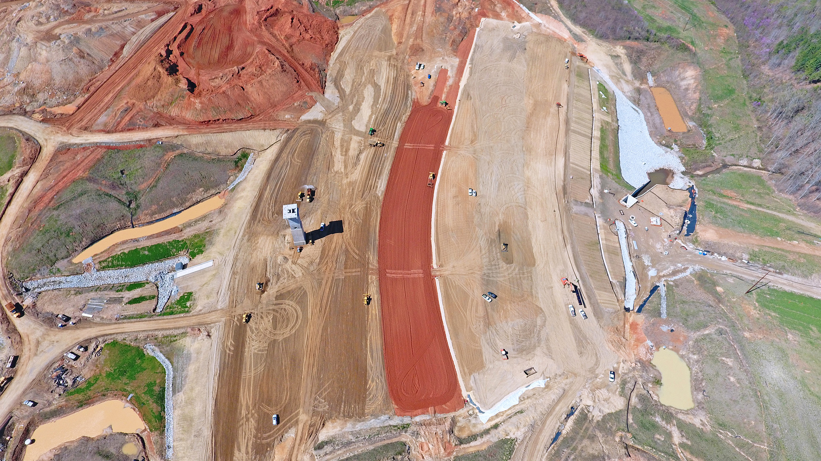
Photo 1: The main dam under construction. The low permeability clay core fill (red) and adjacent shell fill (brown) and chimney drain (gray) layers are clearly visible. On the left side is the inlet/outlet tower, and on the right is an energy dissipator to facilitate discharge into Cobbs Creek.

Slide 3
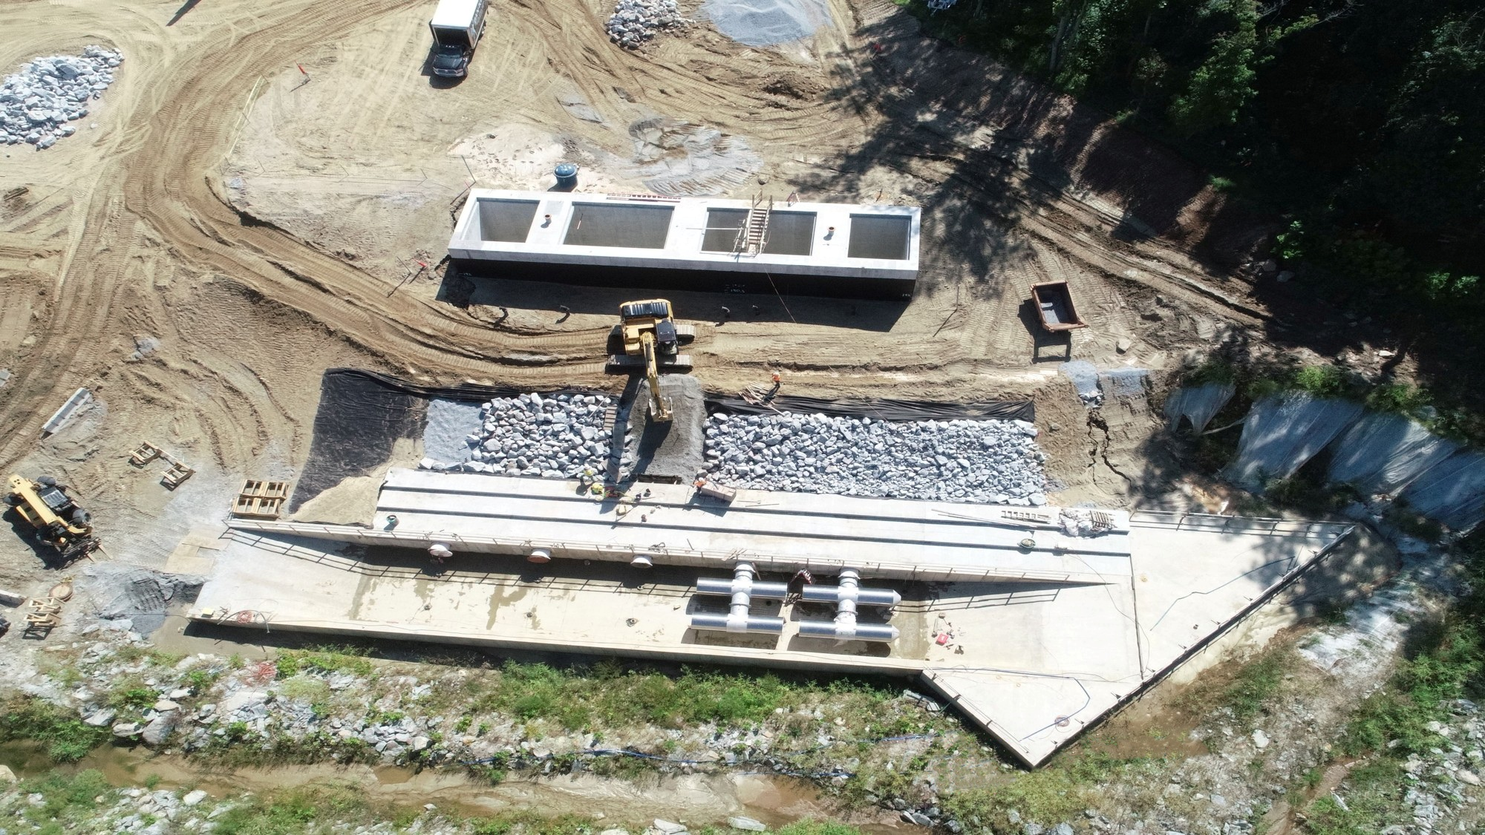
Photo 2: Intake structure no. 1 during the initial fitting of 48-inch diameter cylindrical wedge-wire screens. A cofferdam
^{enabled work in the dry.}

Slide 4
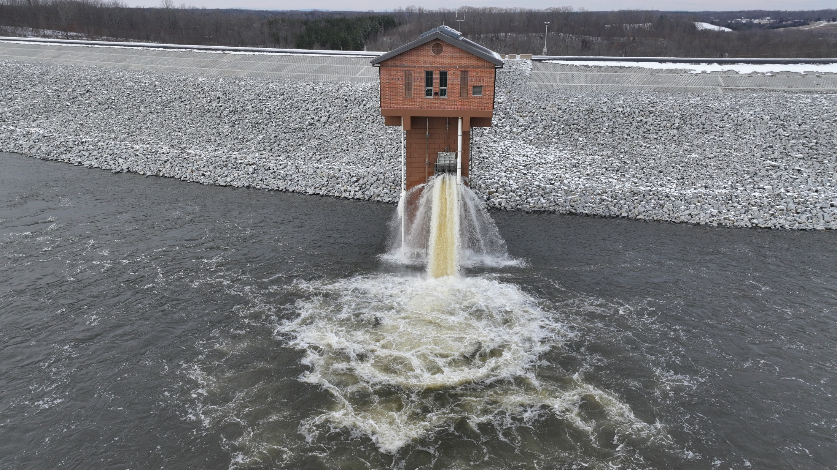
Photo 3:The inlet/outlet tower in use during initial reservoir filling. The process required approximately nine months to complete.

Slide 5
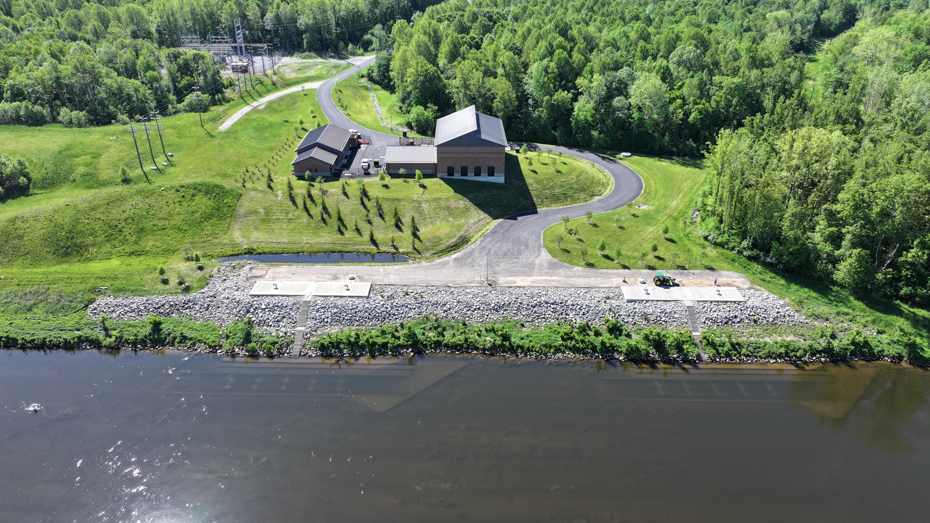
Photo 4: The raw water pump station, operations building, and electric substation sit above the 500-year floodplain. The recessed intake structures allow ten pairs of cylindrical wedge-wire tee screens to be submerged even during periods of low flow in the James River.

Slide 6
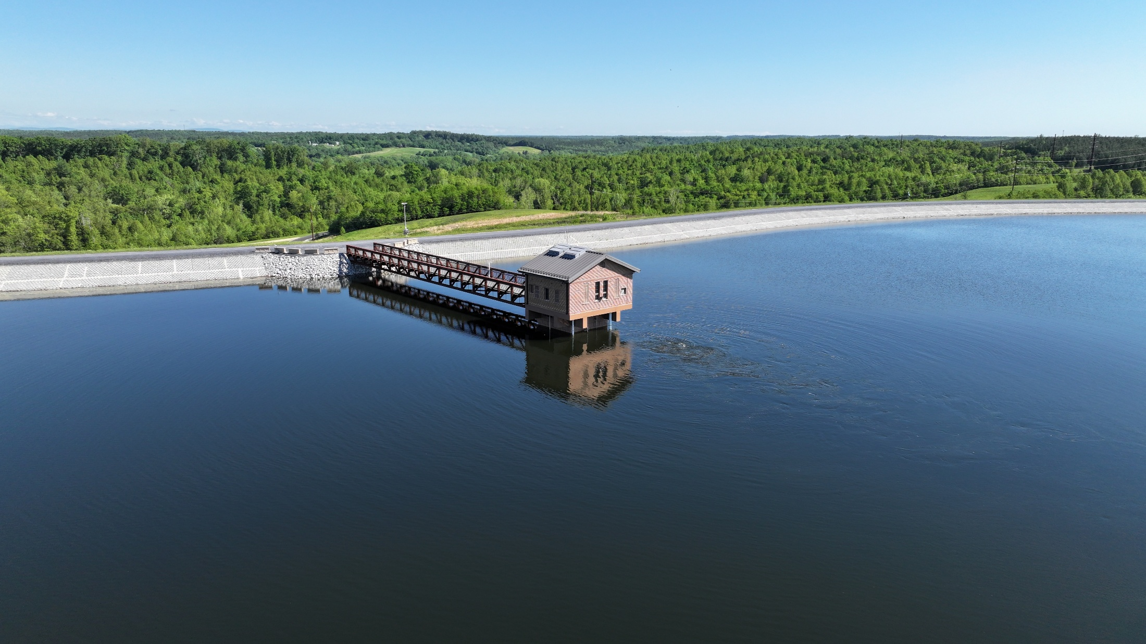
Photo 5: At an overall height of 176 ft, the Inlet/Outlet Tower is the discharge point for water pumped into the reservoir and provides access to the full depth of reservoir storage for releases back to the James River.

Slide 7
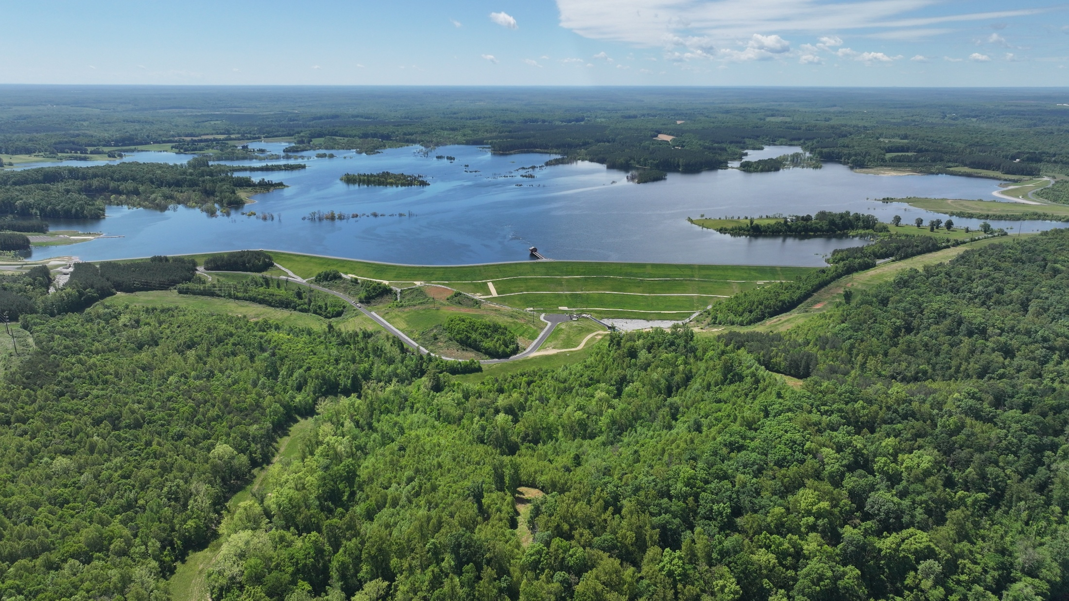
Photo 6: Virgil R. Hazelett Reservoir at Cobbs Creek at full pool, with the main dam in the foreground. The public boat launch facility is visible at the far left of the photo. Standing timber visible within the reservoir pool provides fish and wildlife habitat.

Slide 8
