Slide 1
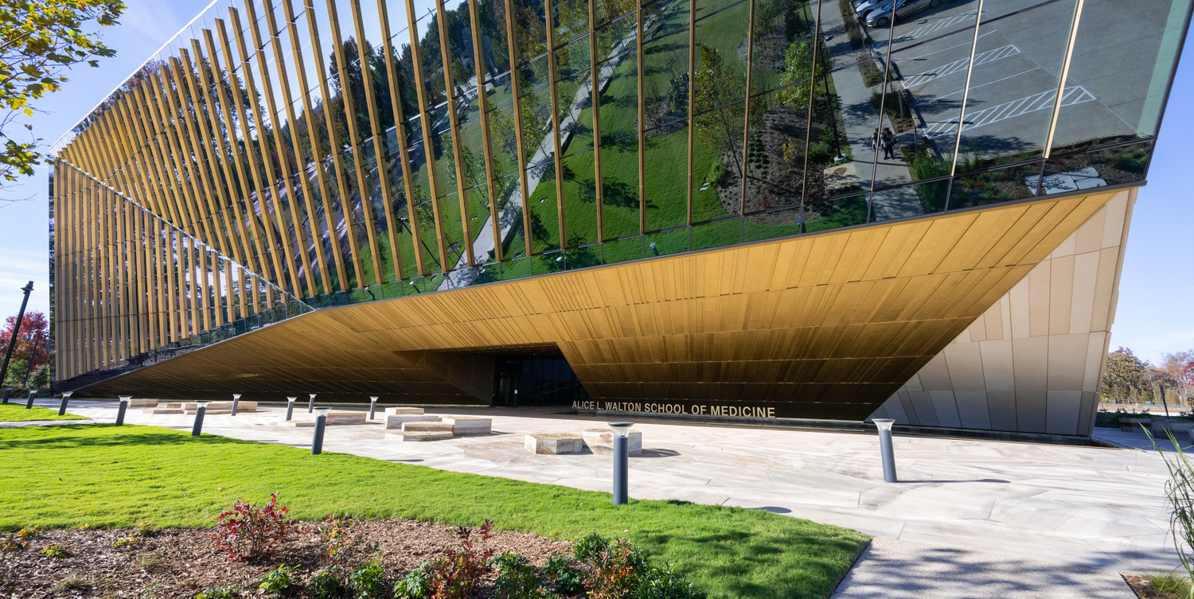


Alice Walton School of Medicine
Martin/Martin, Inc.
Entrant’s Role: Structural Engineering
Client/Owner: Polk Stanley Wilcox
Bentonville, AR

Slide 2
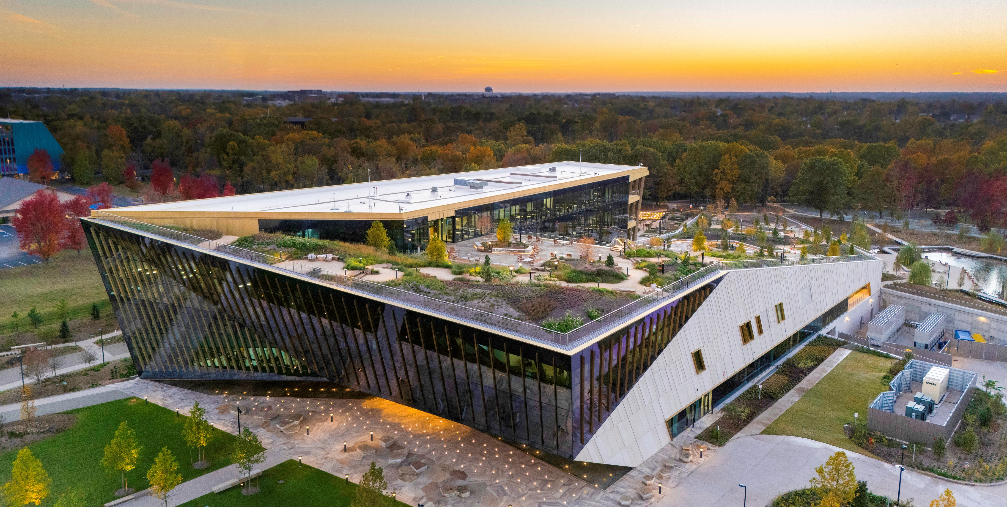
Photo 1 – Aerial image of the complete facility. The building features a dramatic front cantilever and a continuous green roof designed to mimic the natural bluffs found in the surrounding region.

Slide 3
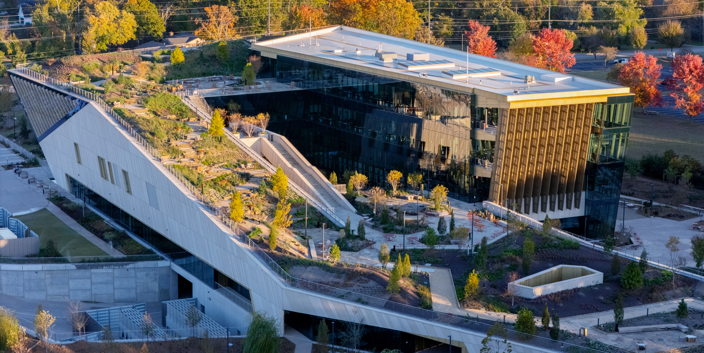
Photo 2 - The rooftop park’s sculpted topography used high-density geofoam to limit structural demand, with intensive media and stonework above occupied space.

Slide 4
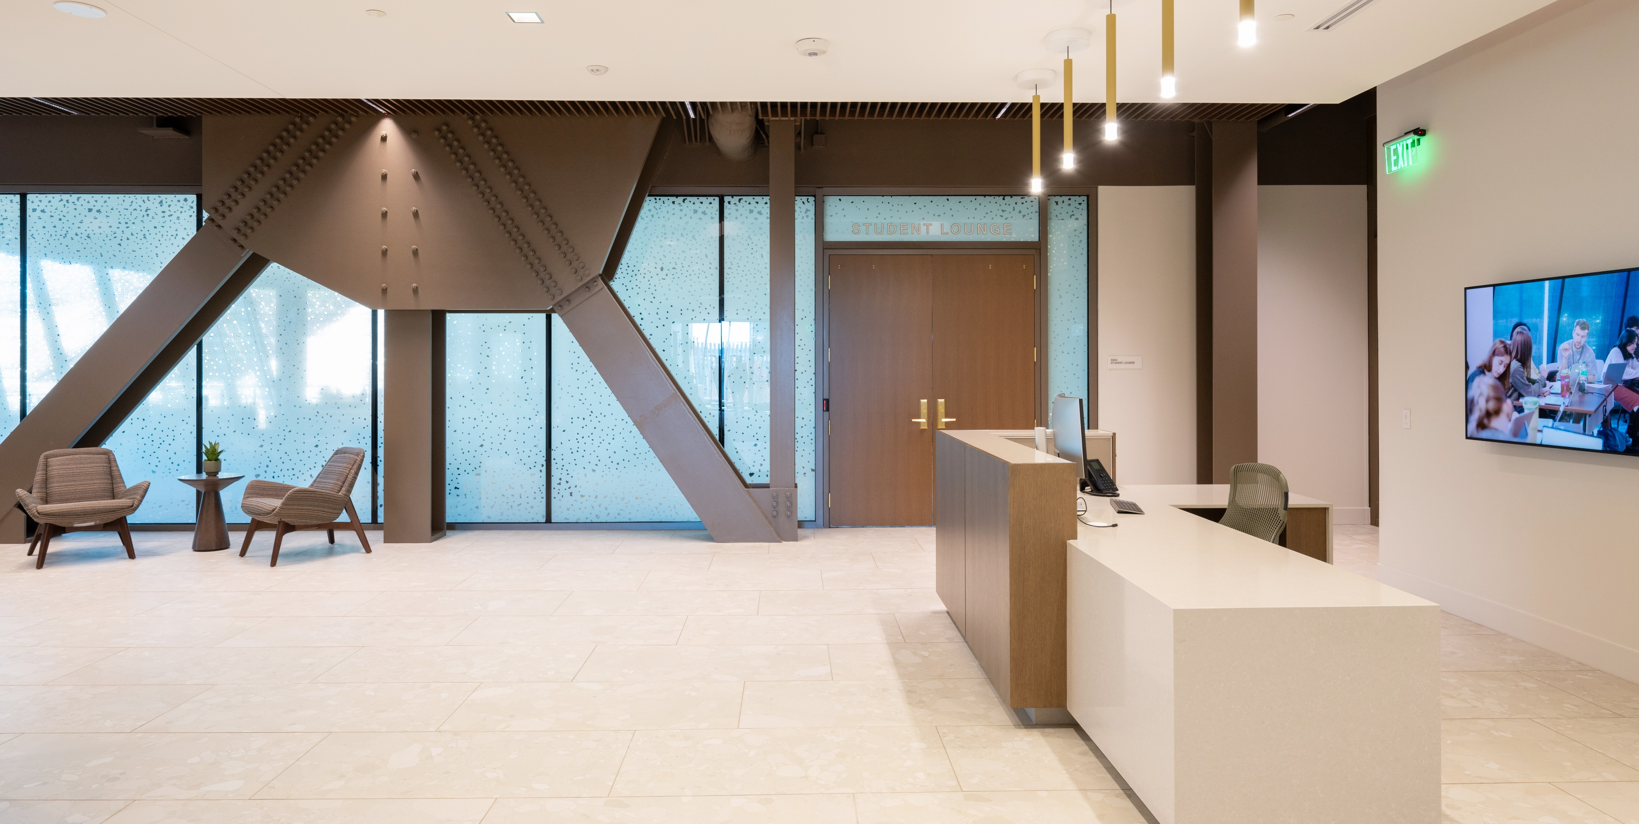
Photo 3 – The 2,950-ton steel frame, featuring numerous large gusset connections, is expressed throughout the interior as a defining design element.

Slide 5
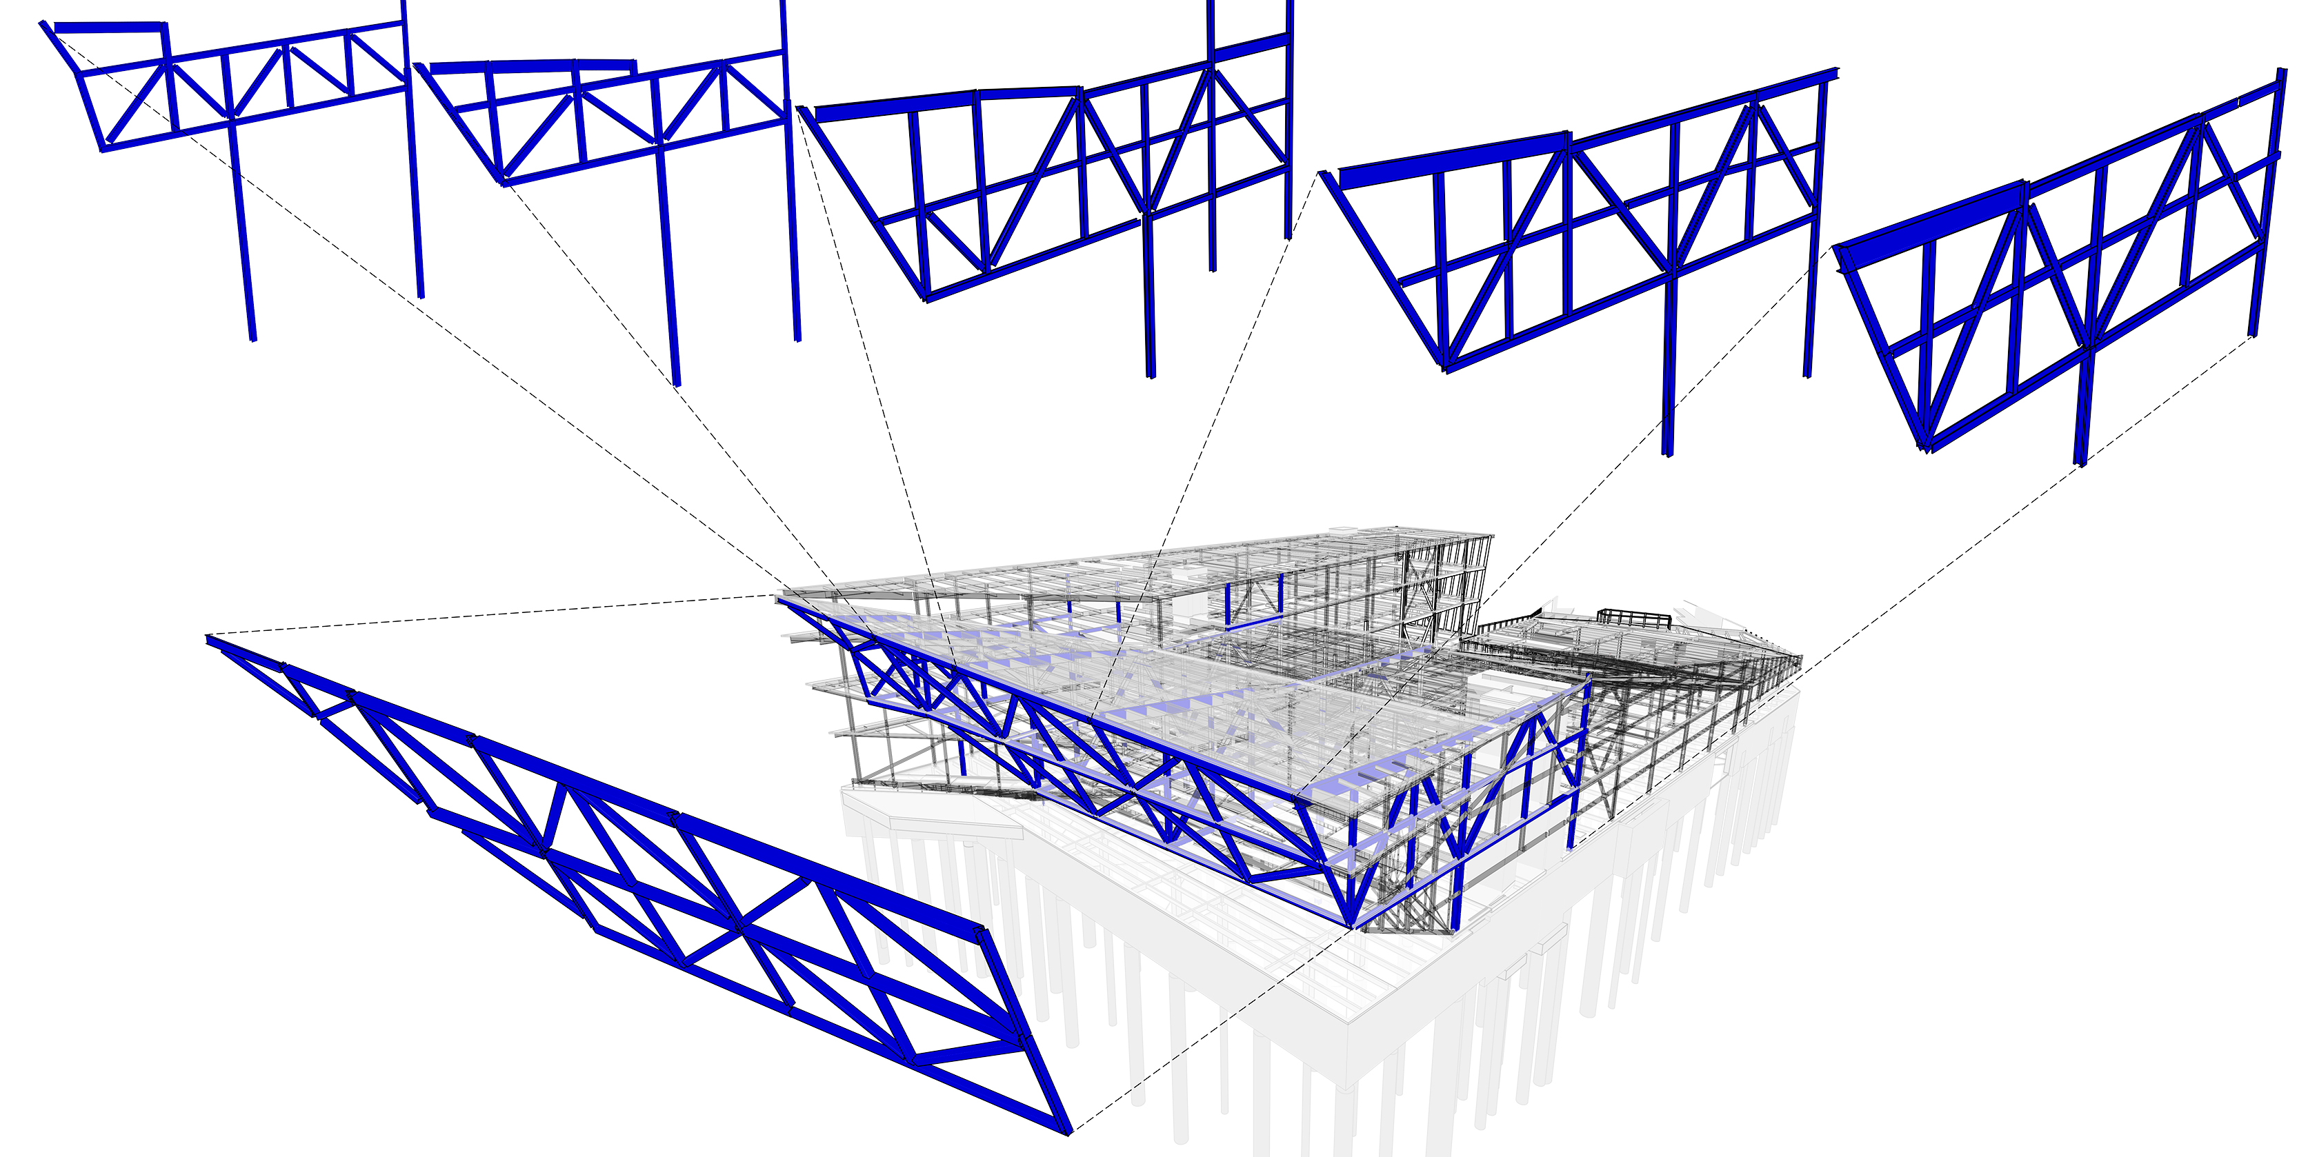
Photo 4 - Transverse Super-Truss Links East-End Cantilevers to increase stiffness; reduce deflection.

Slide 6
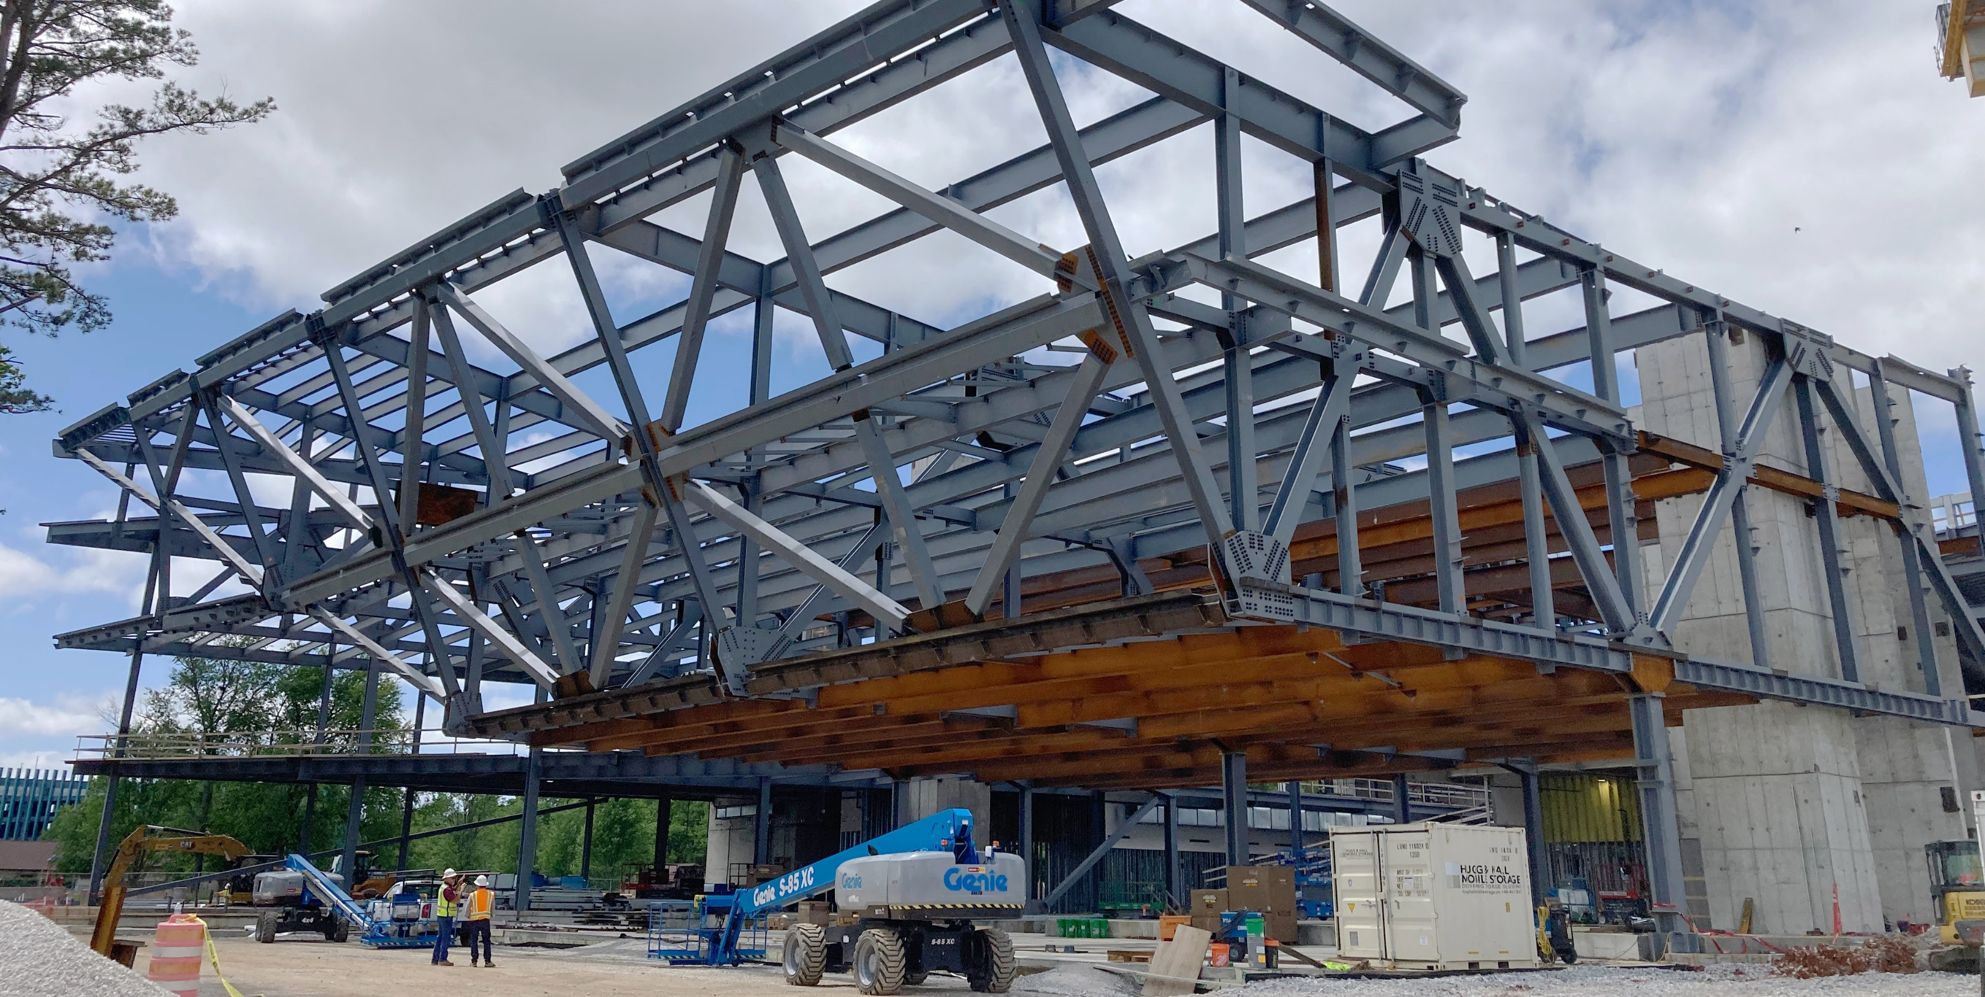
Photo 5 – Construction of the 82 ft cantilever and Super-Truss.

Slide 7
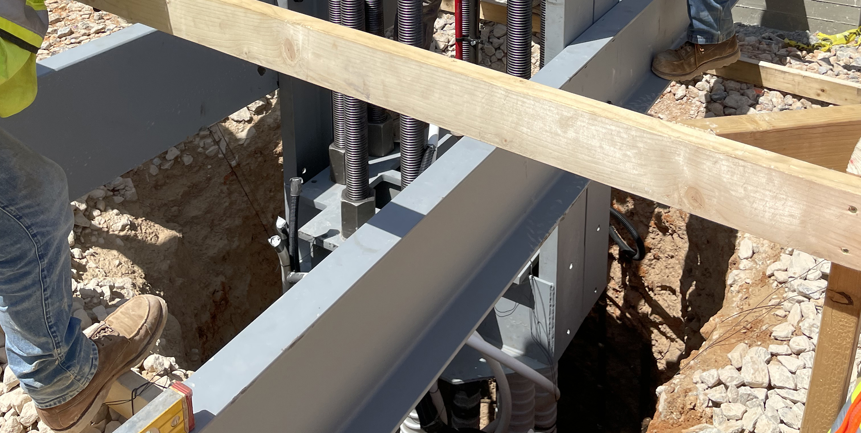
Photo 6 - Finalizing position of DYWIDAG threaded bars prior to pouring drilled pier and prior to post-tensioning the bars to achieve desired concrete compression.

Slide 8
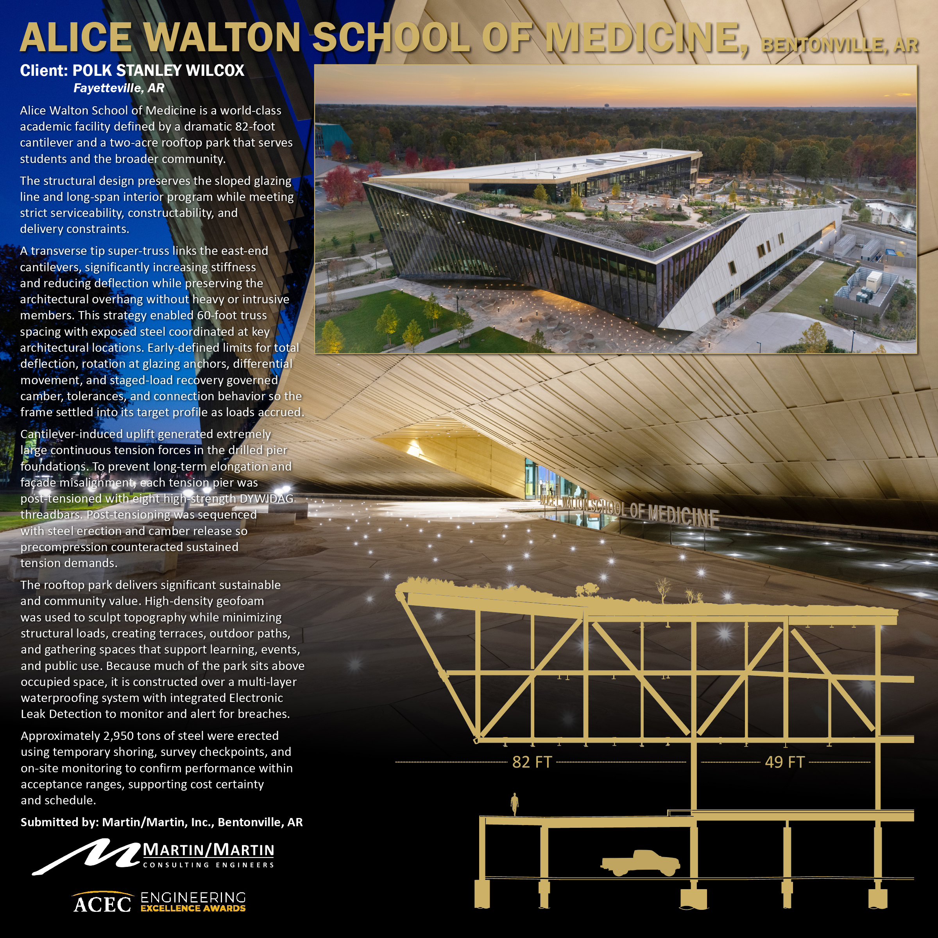
Photographic Display Panel

